Slide 1
Core Eudicots (Core Tricolpates) Superasterids Caryophyllales
Judd et al pp. 442-461

Slide 2
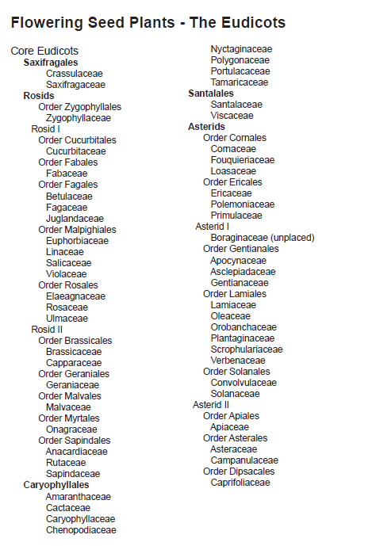
Now in Solanales

Slide 3
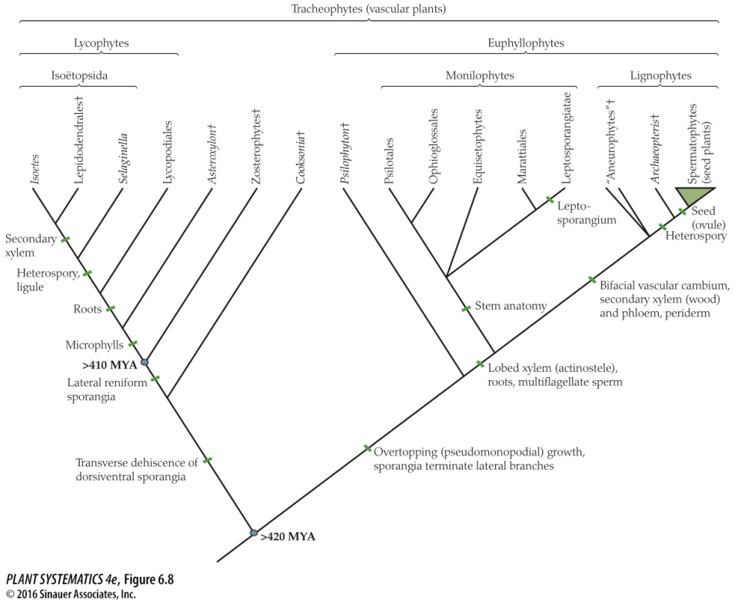
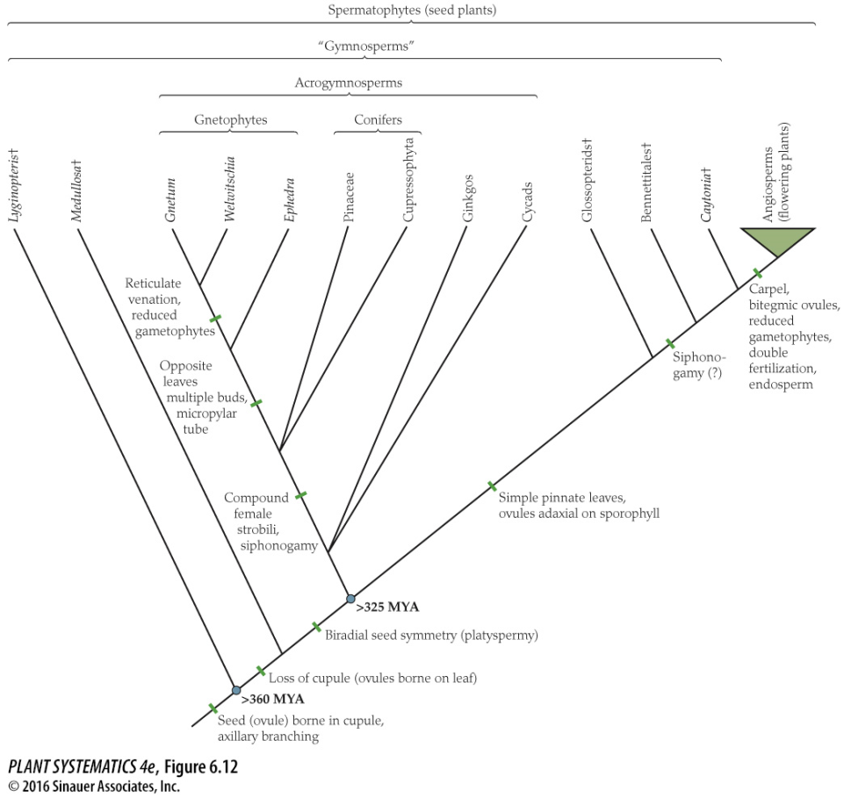
Remember the really big picture…
Mosses, Liverworts, Hornworts
Algae

Slide 4
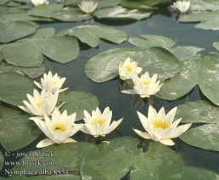
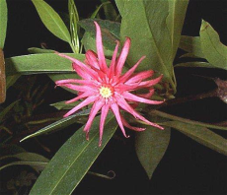
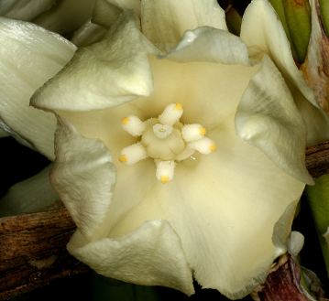
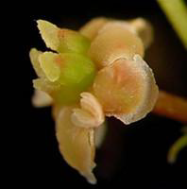
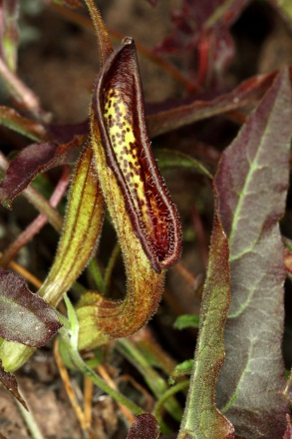
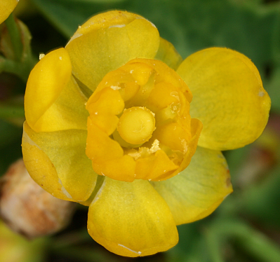
Monocots
Amborella
Nymphaeales
Austrobaileyales
Magnoliids
Eudicots
ANITA Grade
Remember the big picture….
Angiosperm Relationships (old)

Slide 5
Magnoliids
Monocots
Amborella
Nymphaeales
Austrobaileyales
ANA Grade
Remember the big picture….
Eudicots
Angiosperm Relationships (new)
(simplified)

Slide 6
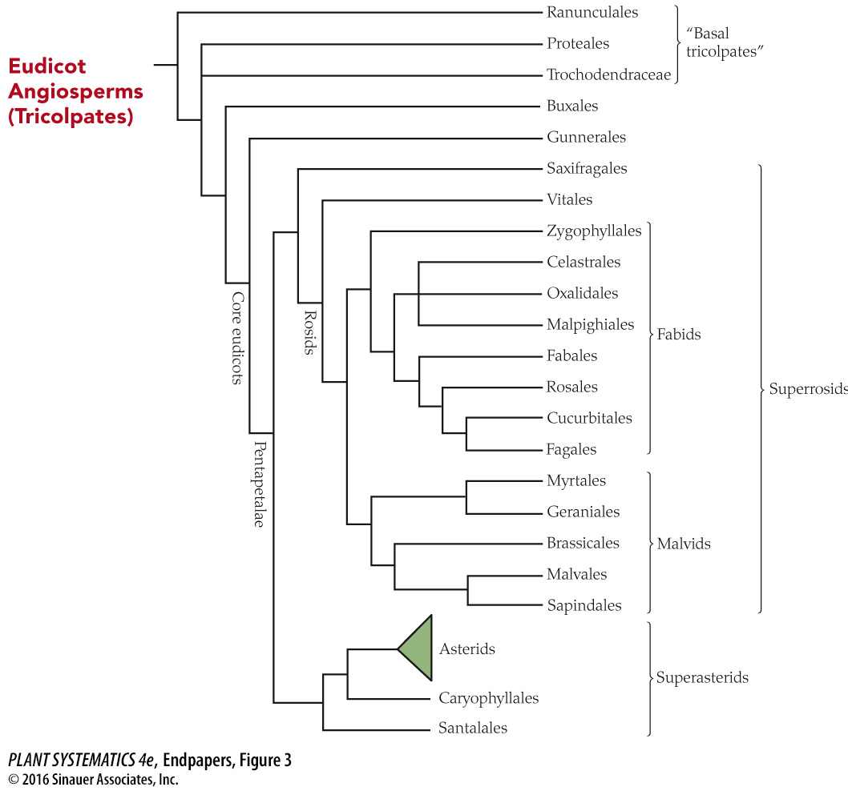
Core Eudicots are a clade supported by rbcL, atpB, matK and 18S sequences.
(matK encodes a protein that helps with intron removal that separates the coding regions of trnK)
You are here!

Slide 7
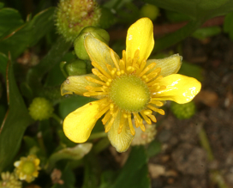
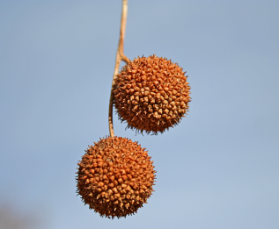
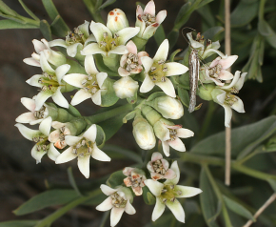
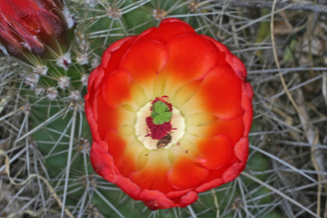
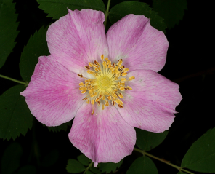
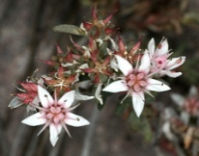
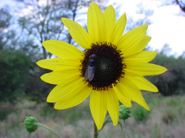
Proteales
Ranunculales
Santalales
Caryophyllales
= Vitales + Fabids + Malvids
Rosids
Saxifragales
Asterids
= Cornales+Ericales+Lamiids+Canpanulids
Superrosids
Superasterids
Basal Eudicots
Simplified Eudicot Phylogeny (Eudicot= Tricolpate)
Core Eudicots

Slide 8
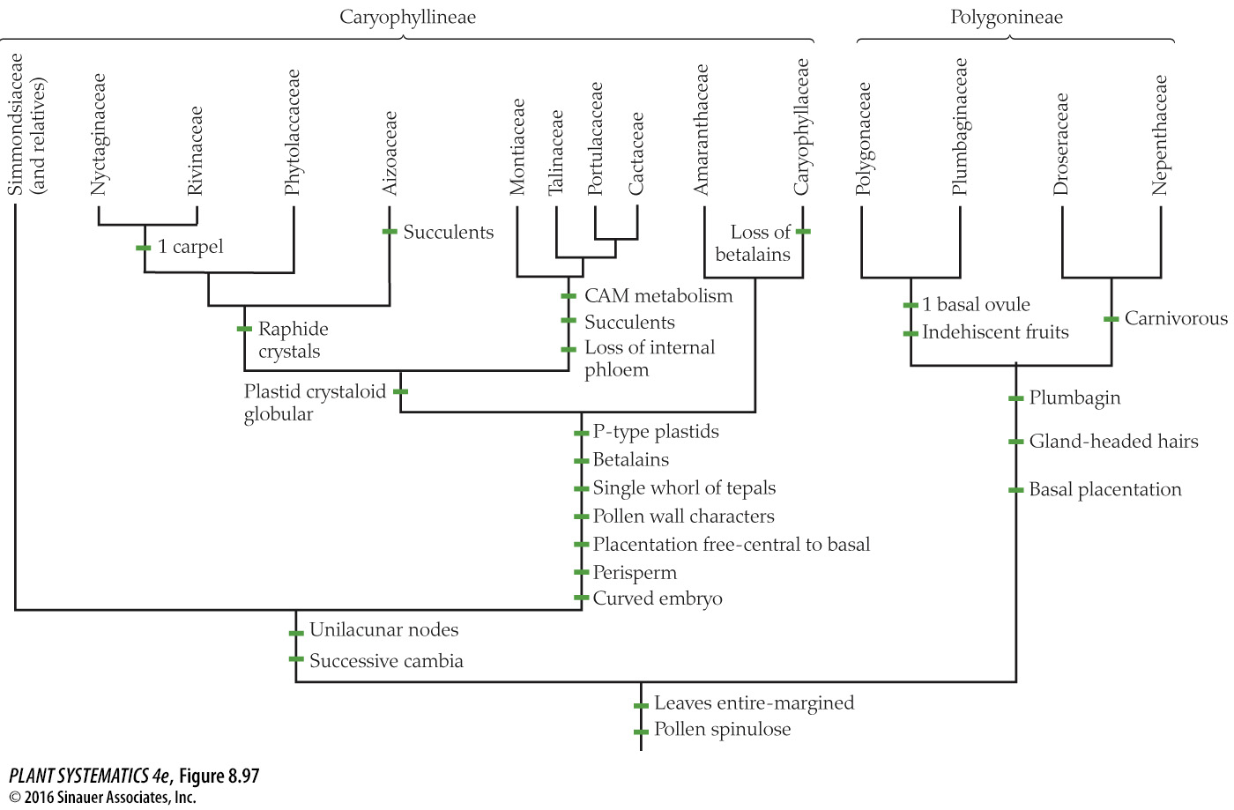
Includes Chenopodiaceae
Blue, cultivars, natice to tropics
Pitcher Plants
Sundews
Needle shaped to repel herbivores
Yellow dye
Betalains or anthocyanins, never both!
Diploid nutritive tissue derived from nucellus; endosperm scanty or lacking
Concentric rings of vascular bundles
Caryophyllales: divided into 2 major clades

Slide 9
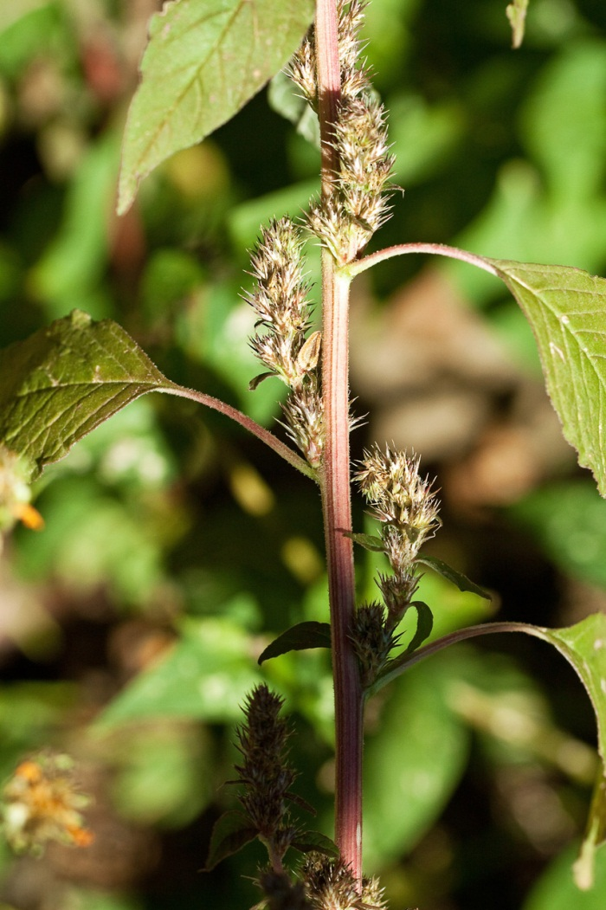
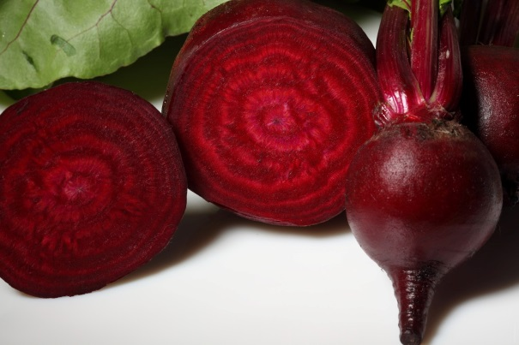
Betalains
Imparts reddish color to the stem; also in beets which are also in the Chenopodiaceae
Beta vulgaris, taproot
Amaranthus palmeri
Kochia scoparia at Saddlerock

Slide 10
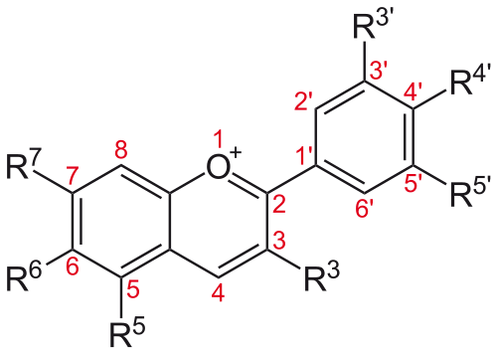
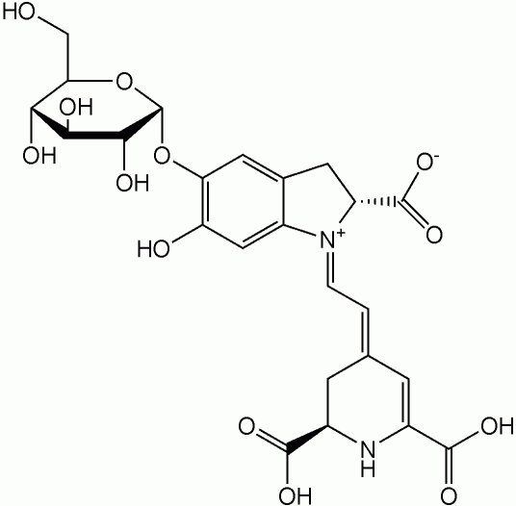
Two Large Classes of Plant Pigments
Basic flavonoid structure= 2 aromatic rings connected by 3-carbon bridge
Imparts a red or yellow color to plant stems and leaves
OR
Anthocyanins
Betalains
As in Caryophyllaceae and most other eudicots; flavonoids, antioxidant, nature’s sunscreen. Blue, purple, red.
As in the rest of the Caryophyllineae, not flavonoid. It’s a plant alkaloid– synthesized from tyrosine.
Plants have one or the other, not both

Slide 11
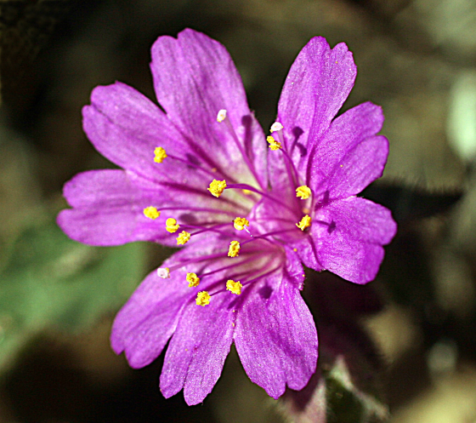
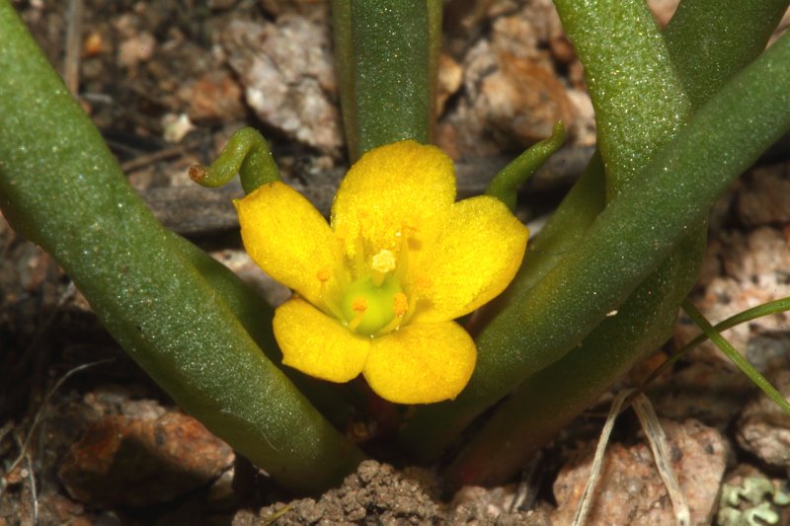
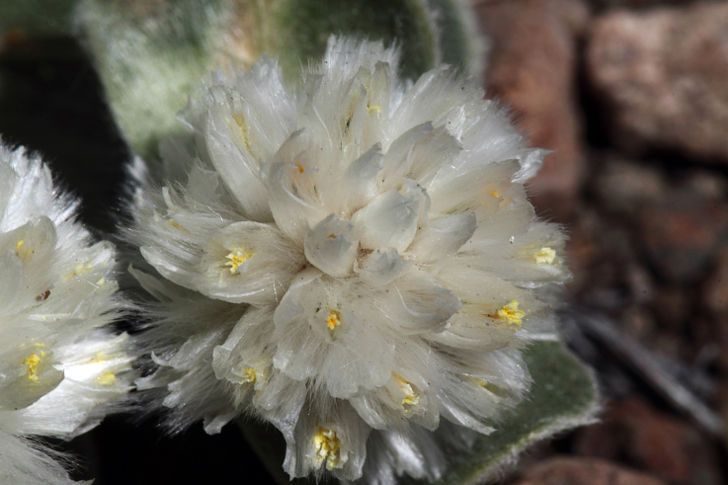
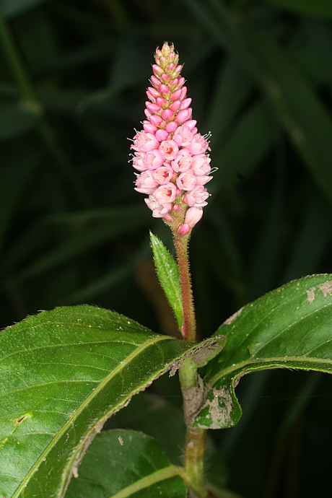
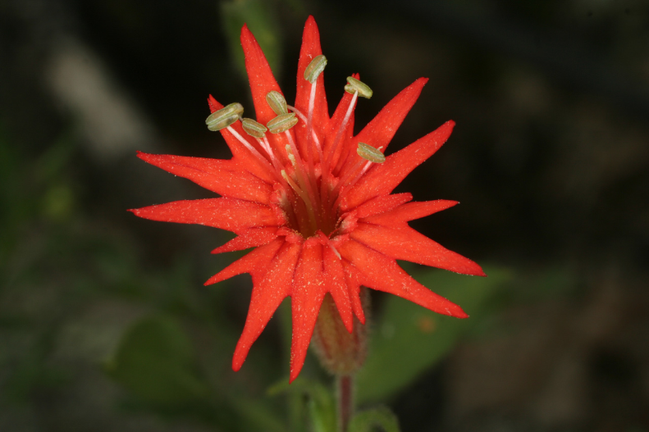
Echinocereus coccineus
(Cactaceae)
Allionia incarnata
(Nyctaginaceae)
Phemeranthus humilis
(“Portulacaceae”)
Gomphrena caespitosa
(Amaranthaceae)
Silene laciniata (Caryophyllaceae)
Persicaria amphibia
(Polygonaceae)

Slide 12
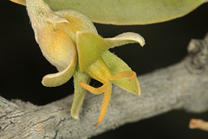
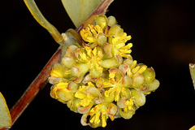
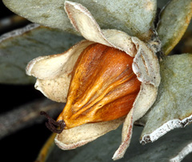
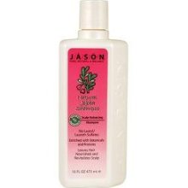
Simmondsiaceae: Simmondsia chinensis (Jojoba)
Jojoba shampoo, oil also used in cosmetics

Slide 13
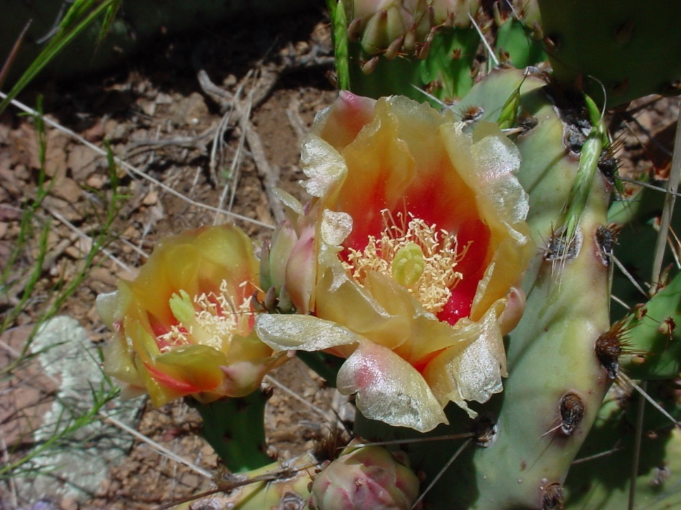
Eudicots: Caryophyllales: Cactaceae Opuntia phaeacantha
Cacti are found in their native environment only in the New World, with ONE exception– the genus Rhipsalis. It is an epiphytic plant, native to South America, but also is found in Africa and Madagascar.
tepals

Slide 14
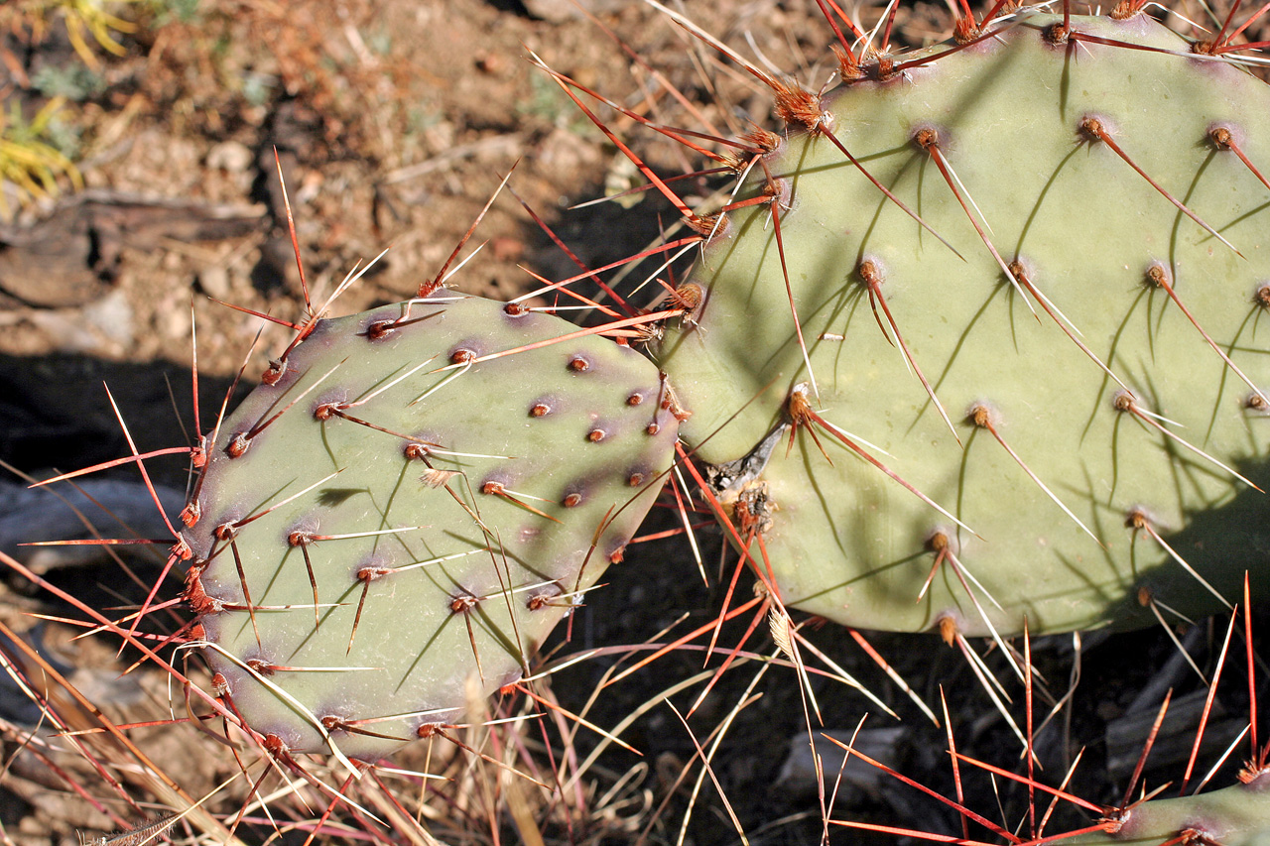
Eudicots: Caryophyllales: Cactaceae: Opuntia phaeacantha

Slide 15
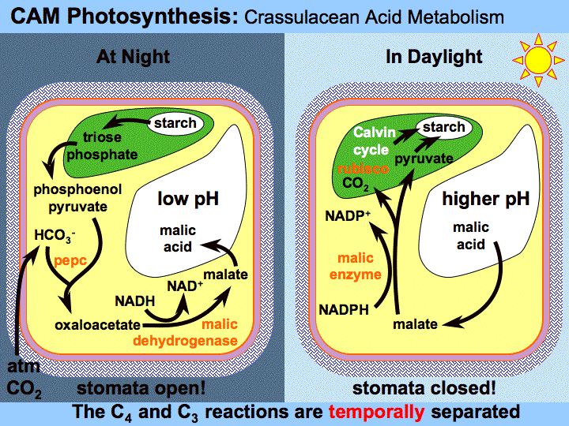
At night with stomata open, CO2 is taken up into malate and stored in vacuoles. During the day, stomata are closed and the Calvin Cycle proceeds.

Slide 16
Other Adaptations for Life in Arid Environment
Wide spreading shallow root system, sometimes also with a deep taproot
Stems with thick cuticle
Epidermis with sunken stomata

Slide 17
Thorns, Spines, and Prickles
Prickles are epidermal outgrowths like hairs
Thorns are modified branches or stems
Spines are modified leaves or stipules

Slide 18
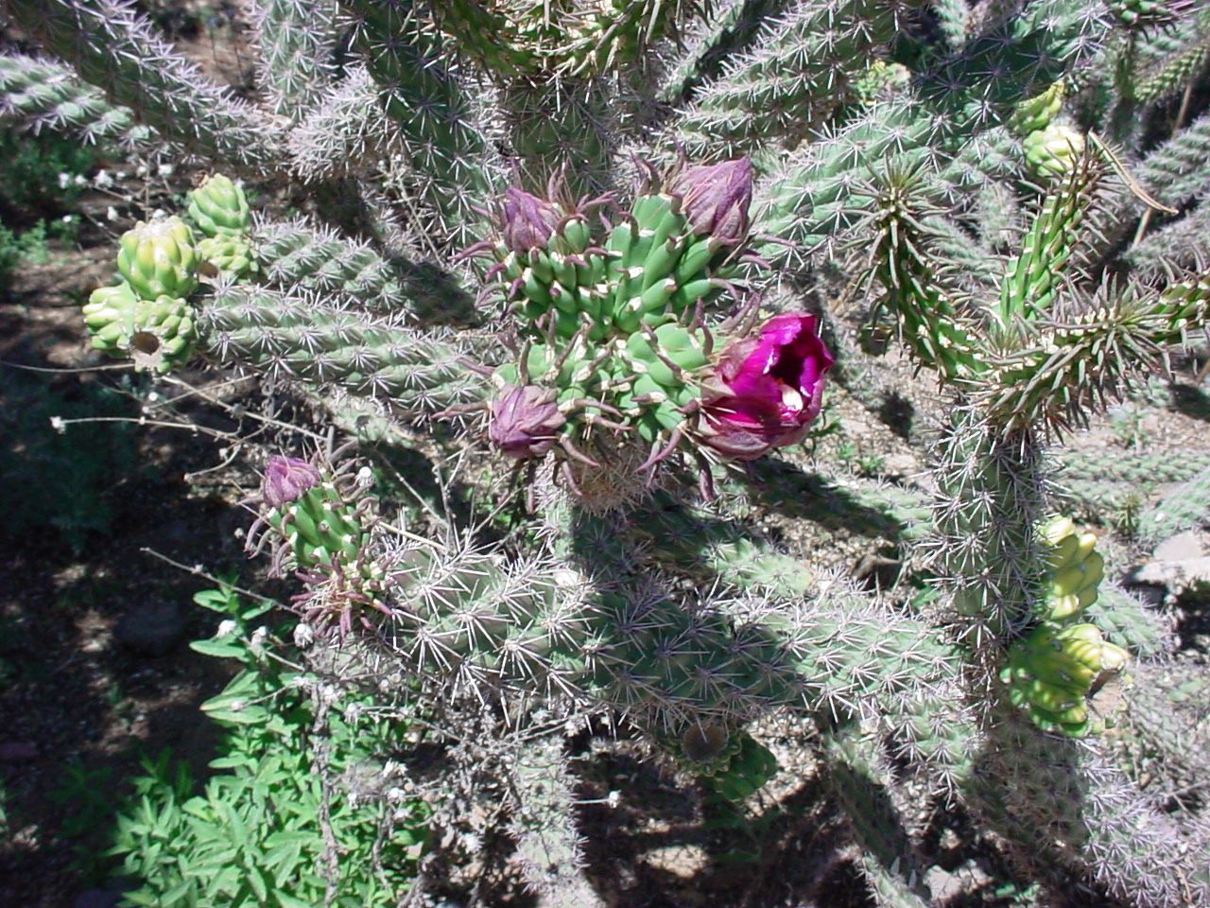
Cactus Spines– a special case.
Cactus spines arise in the early deciduous leaf axil in an area termed the areole. However, they are homologous to bud scales rather than to stems and so are not modified stems but rather modified leaves (spines.)
Cactus leaves
(caducous)

Slide 19
Cactus
Areole= spiny short shoot
Spine= modified leaf, bud scale in this case
Glochids are small, easily detachable irritating hairs
Areole
Spine
Glochid
This is the long shoot.

Slide 20
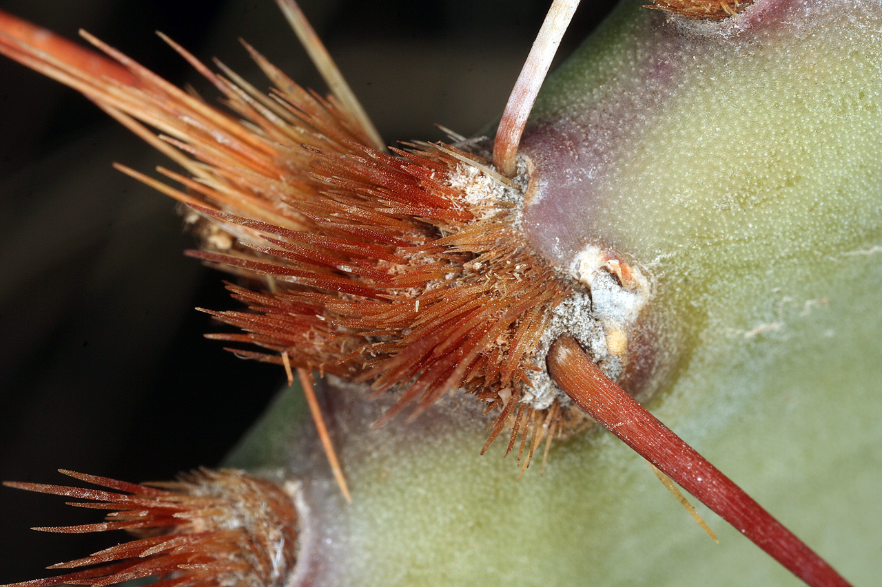
Eudicots: Caryophyllales: Cactaceae: Opuntia phaeacantha

Slide 21
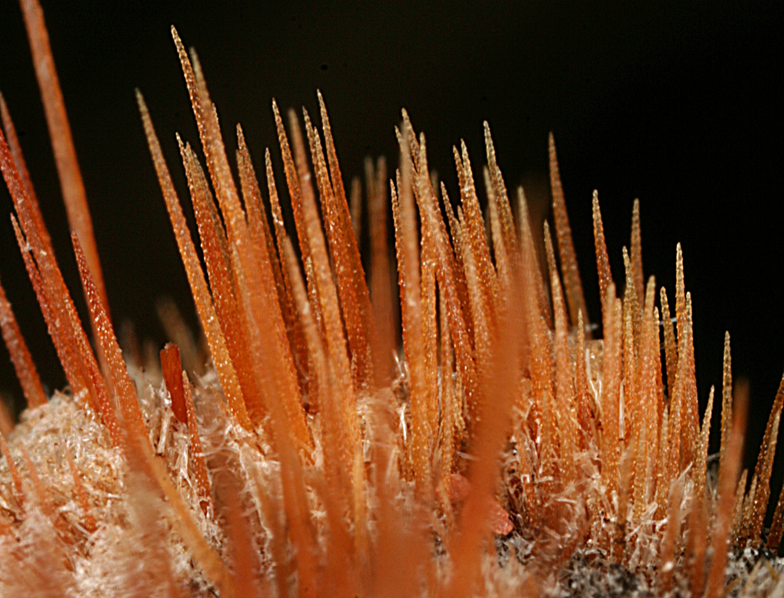
Eudicots: Caryphyllales: Cactaceae: Opuntia phaeacantha

Slide 22
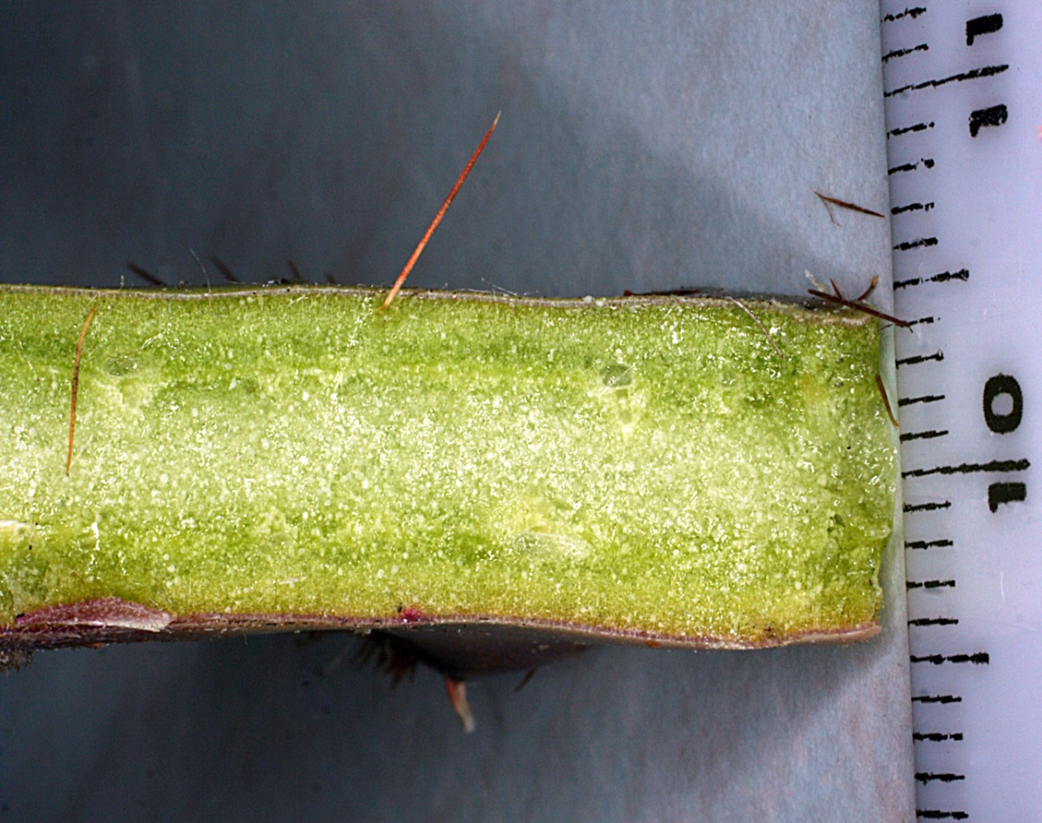
Eudicots: Caryophyllales: Cactaceae: Opuntia phaeacantha
The cross section of a joint shows a thickened "chlorenchyma," the dark green layer just under the surface. This layer is about 5 times as thick as in other types of plants (ones with lots of leaves) and is where the chlorophyll containing chloroplasts are most abundantly found

Slide 23
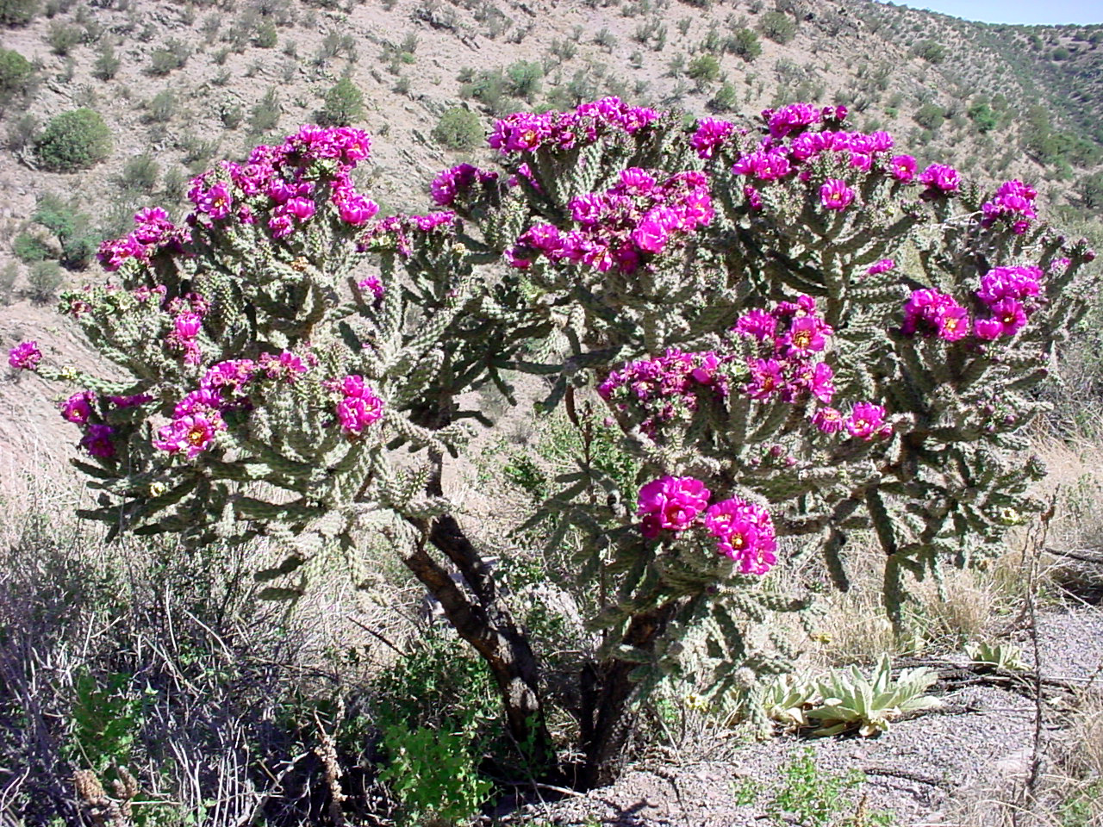
Eudicots: Caryophyllales: Cactaceae: Cylindropuntia spinosior

Slide 24
Eudicots: Caryophyllales: Cactaceae: Cylindropuntia spinosior
Note the quickly falling, short lived leaves

Slide 25
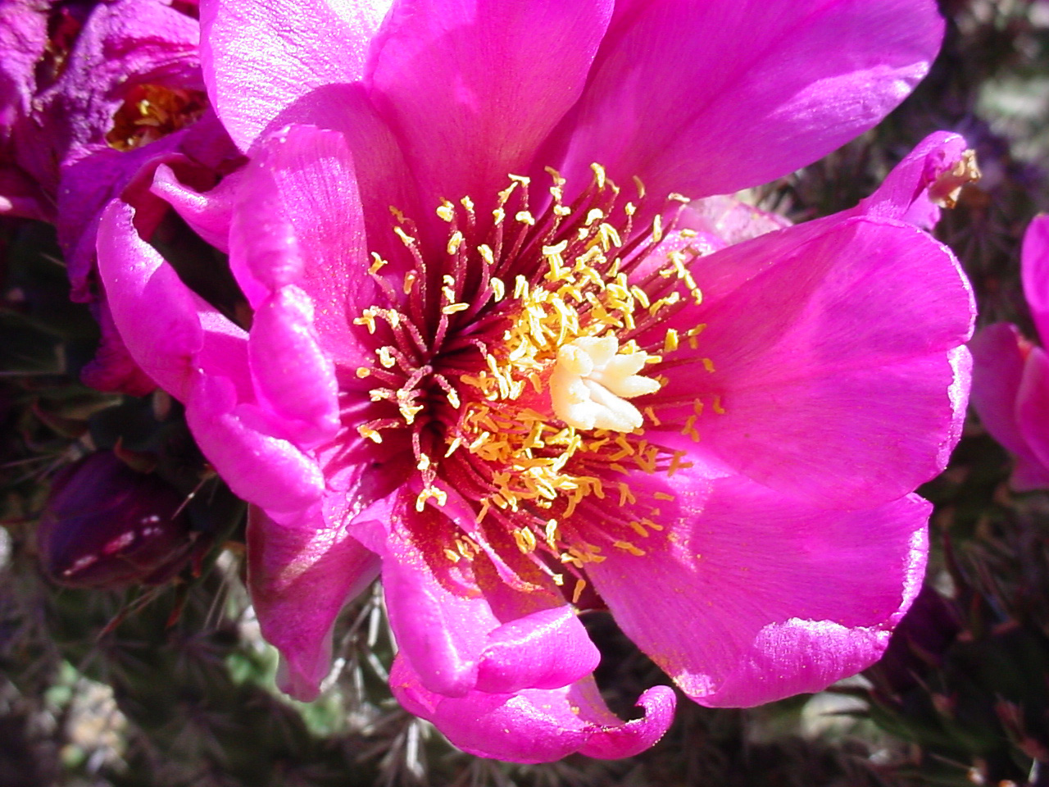
Eudicots: Caryophyllales: Cactaceae: Cylindropuntia spinosior
Stamens sensitive to touch!

Slide 26
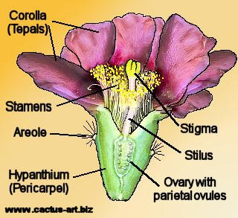
Cactus Flowers
Opuntia

Slide 27
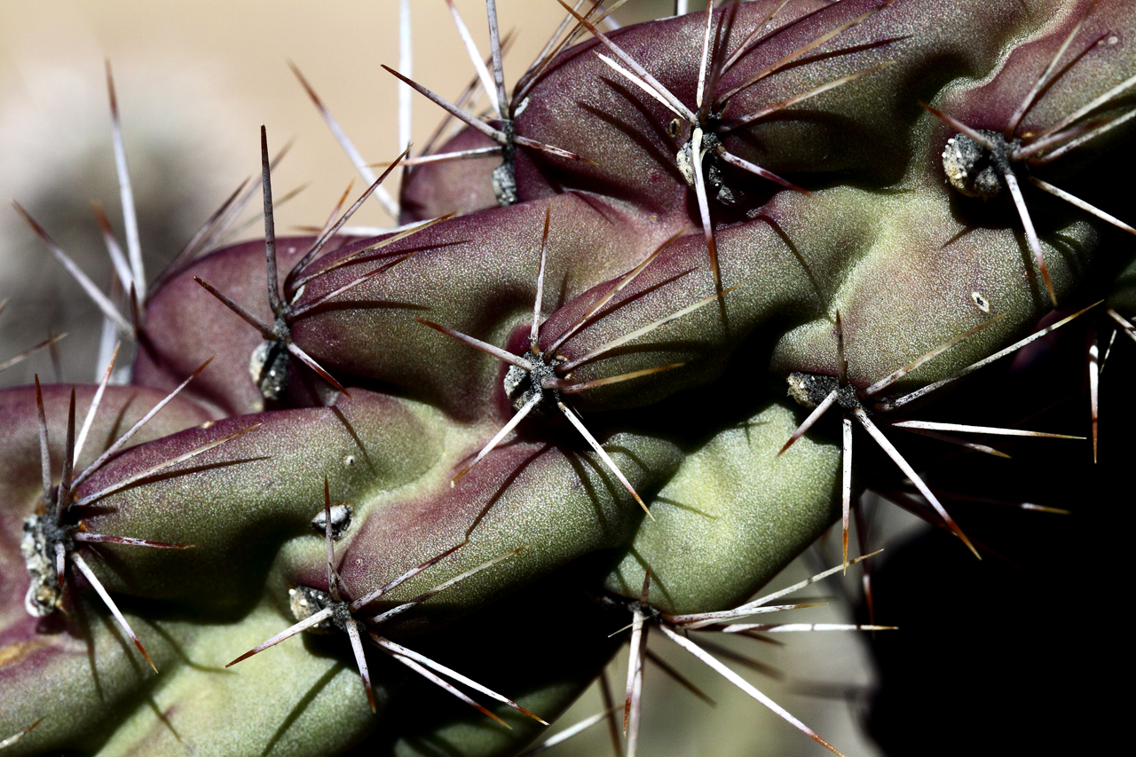
Eudicots: Caryophyllales: Cactaceae: Cylindropuntia spinosior

Slide 28
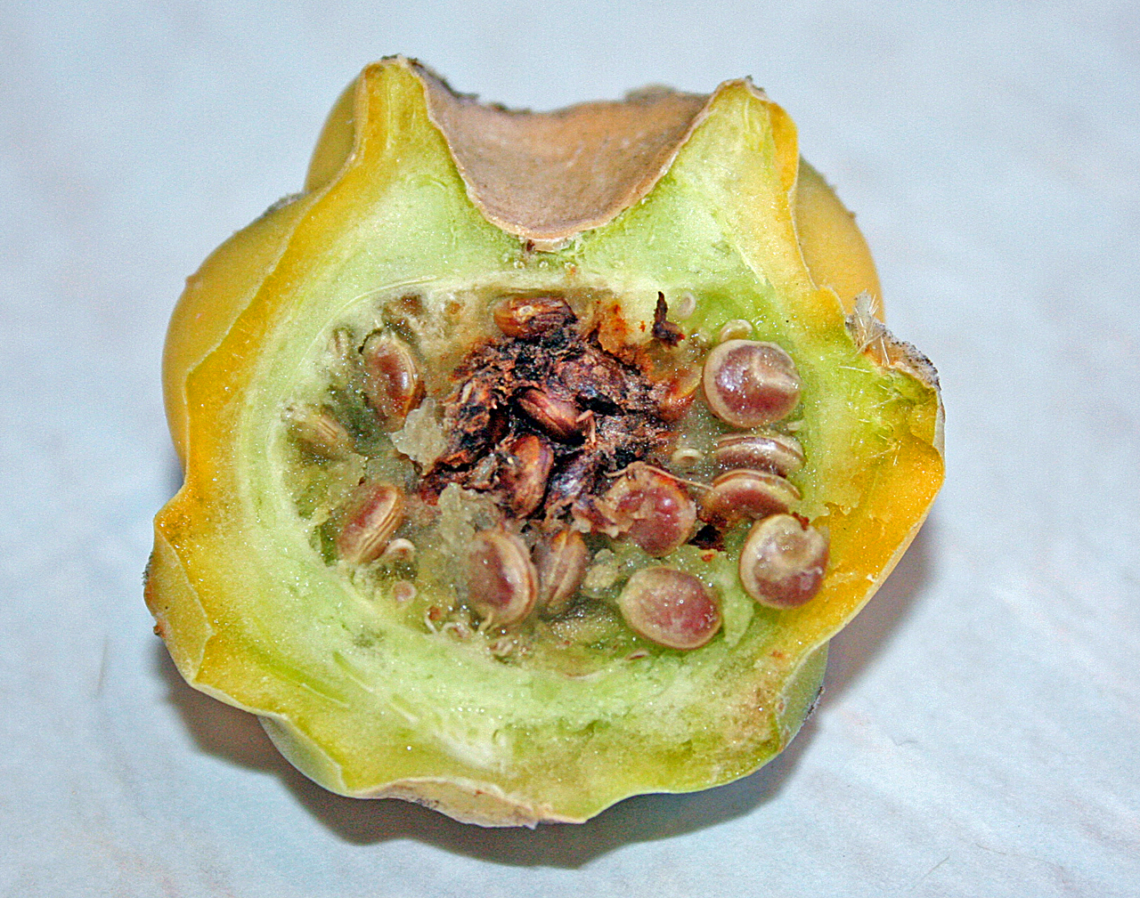
Eudicots: Caryophyllales: Cactaceae: Cylindropuntia spinosior
Fruit is a berry
Seeds are girdled (arillate)

Slide 29
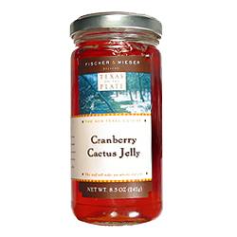
Cactus “Products”
Cactus are used as food, ornamentals, hallucinogens

Slide 30
Cactus Hallucinogens
Peyote

Slide 31
Touch Sensitive Stamens: Lophophora and Cylindropuntia, & other cacti
Play video file
Henslow (1837): “The flowers of Opuntia…had one day arrested Darwin’s attention by the great irritability which their stamens manifested upon his inserting a piece of straw into the tube, when they immediately collapsed around the pistil and the segments of the perianth soon after closed also.”

Slide 32
Video of touch sensitive stamens: thigmonasty– mediated by turgor pressure in cells

Slide 33
Eudicots: Caryophyllales: Cactaceae
succulent, spiny stems, leaves reduced and falling quickly;
long shoots have caducous leaves, short shoots have spines and glochids; betalains present
Foliage–
Calyx
Corolla
Androecium–
Gynoecium–
Fruit–
Tepals numerous, distinct and petal-like
numerous distinct touch sensitive stamens
ovary becoming inferior, usually many connate carpels
berry; seeds can be arillate

Slide 34
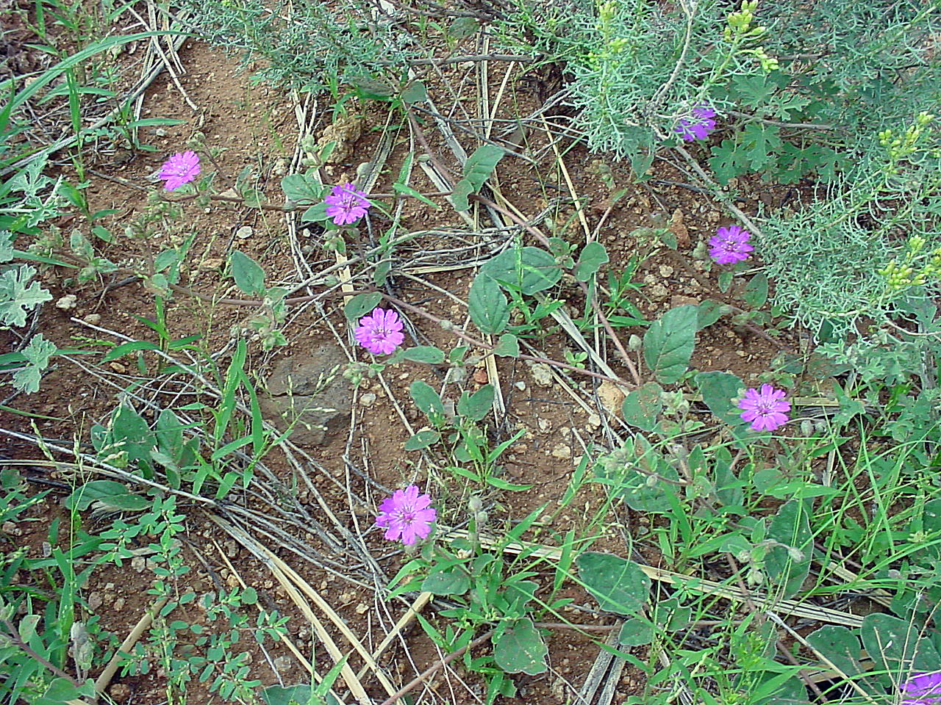
Eudicots: Caryphyllales: Nyctaginaceae: Allionia incarnata

Slide 35
Eudicots: Caryophyllales: Nyctaginaceae: Allionia incarnata

Slide 36
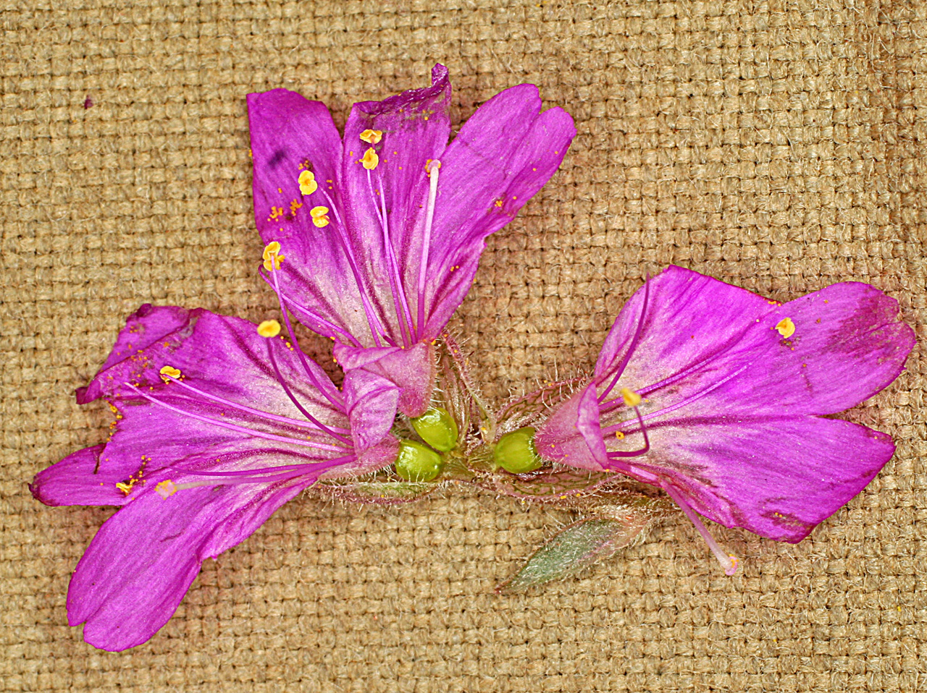
Eudicots: Caryophyllales: Nyctaginaceae: Allionia incarnata
Tepals connate forming a distinct tube, the proximal portion of which is green and differentiated from the distal petal like portion. Ovary is superior but appears inferior because it is enclosed in the green constricted portion of the perianth tube.
Sepal-like involucre

Slide 37
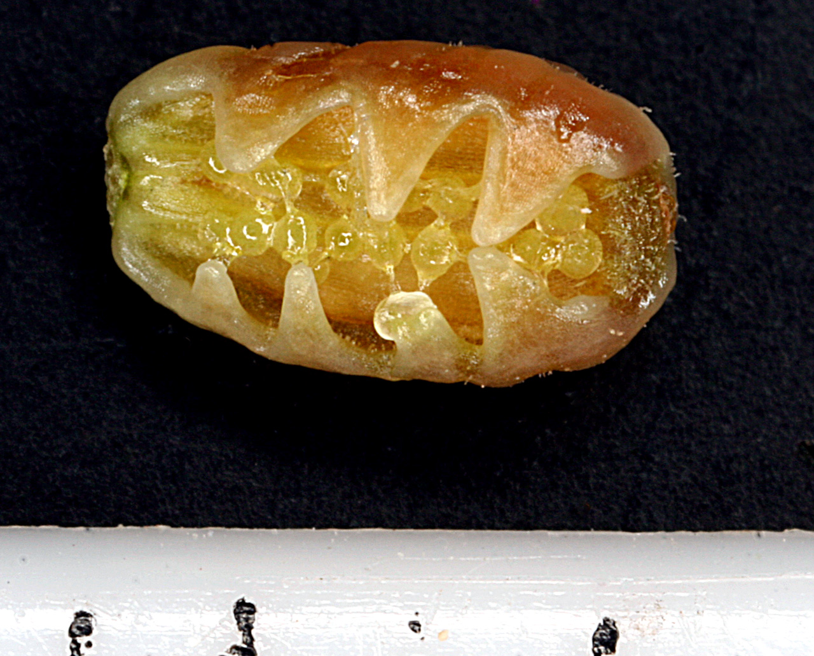
Eudicots: Caryophyllales: Nyctaginaceae: Allionia incarnata
Fruits is an achene enclosed in a persistant leathery to fleshy basal portion of the perianth tube, may have lines of sticky, gland headed hairs.

Slide 38
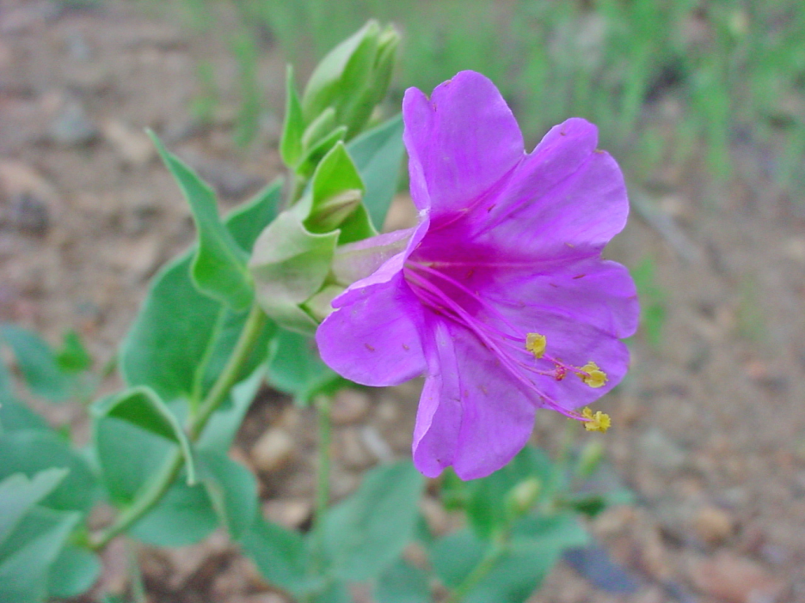
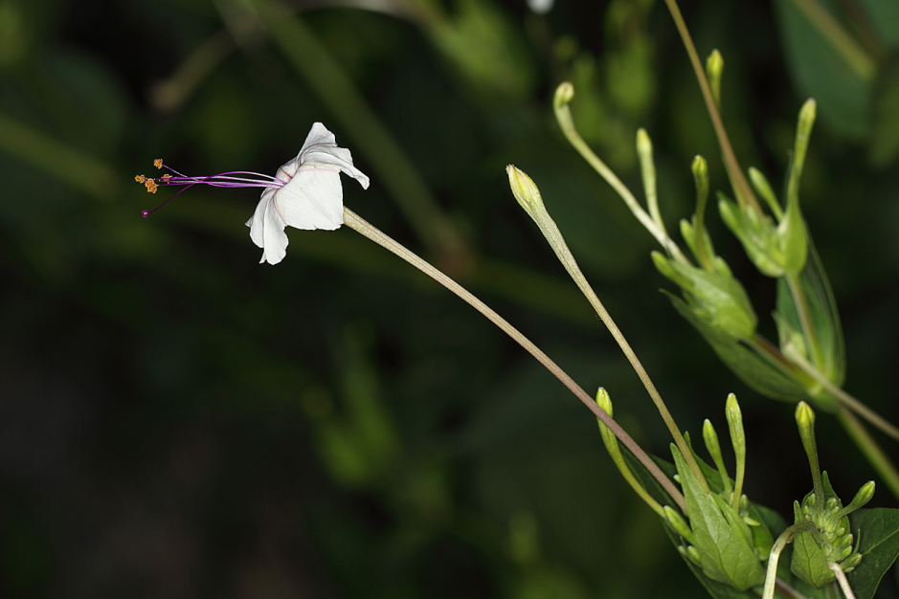
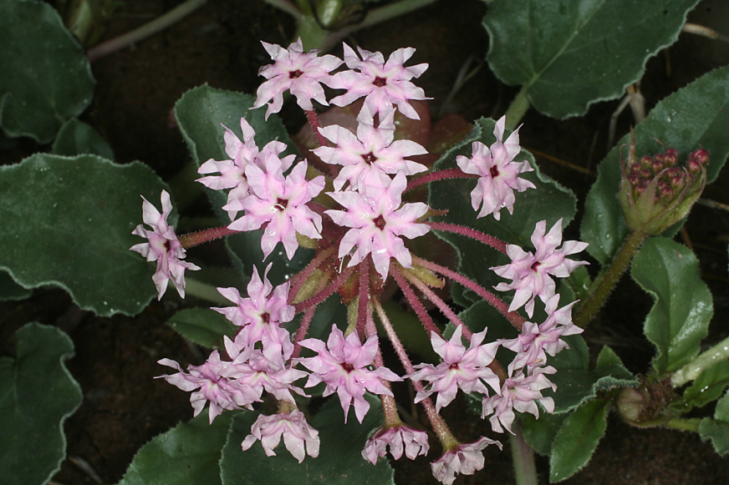
Other Nyctaginaceae
Mirabilis longiflora
Mirabilis multiflora
Trypterocalyx carneus
Boerhaavia coccinea

Slide 39
Eudicots: Caryophyllales: Nyctaginaceae: Allionia incarnata
leaves opposite, betalains present, hairy, involucres sepal-like with one or more flowers per involucre
Foliage–
Calyx–
Corolla--
Androecium–
Gynoecium–
Fruit–
Tepals (usually 5) connate into distinct tube with proximal green and distal petal like portions.
Usually five distinct stamens
Ovary superior, but looks inferior
achene, enclosed in persistant perianth tube– a situation called an “anthocarp”

Slide 40
Eudicots: Caryophyllales: Amaranthaceae: Amaranthus palmeri
Flowers with dense papery bracts
Fruit a utricle, a “small, thin walled one seeded more or less bladdery inflated fruit”

Slide 41
AMARANTHACEAE
Amaranthus

Slide 42
Other Amaranthaceae
Chenopodiaceae now included in Amaranthaceae on basis of molecular studies
Salsola tragus
Atriplex canescens Fruit achene with persistent bracts

Slide 43
Distinct stamens
Carpellate flower
Amaranthaceae (Chenopodiaceae) Chenopodium album

Slide 44
Eudicots: Caryophyllales: Amaranthaceae: Amaranthus palmeri
Foliage–
Calyx—
Corolla—
Androecium–
Gynoecium–
Fruit–
betalains present, very bracteate inflorescence
Flowers often densely clustered and small. 3-5 distinct to slightly connate tepals
3-5 stamens, can be distinct or connate
Carpels usually 2 or 3 connate, ovary superior
Utricle in Amaranthus (but achene or capsule in other Amaranthaceae)

Slide 45
Eudicots: Caryophyllales: Polygonaceae: Persicaria lapathifolia
Growth habit
Ocrea: stipules connate into thin sheath around stem

Slide 46
Eudicots: Caryophyllales: Polygonaceae
Rumex hymenosepalus
Eriogonum wrightii
Eriogonum species have no ocrea

Slide 47
Eudicots: Caryophyllales: Polygonaceae: Persicaria lapathifolia
Foliage–
Calyx–
Corolla—
Androecium–
Gynoecium–
Fruit–
easily recognizable by distinctive ocrea; anthocyanins and not betalains
5 or 6 distinct tepals, usually small flowers
5-9 stamens with distinct filaments
ovary superior, 2 or 3 carpels connate
nutlet (small seed covered by a hard layer), indehiscent and dry

Slide 48
Eudicots: Caryophyllales: Caryophyllaceae (betalains lost)
Silene laciniata
Stellaria porsildii

Slide 49
Eudicots: Caryophyllales: Caryophyllaceae (betalains lost)
Drymaria molluginea
Cerastium fastigiatum

Slide 50
Eudicots: Caryophyllales: Caryophyllaceae: Silene laciniata
Foliage–
Calyx—
Corolla–
Androecium–
Gynoecium–
Fruit–
betalains lost, anthocyanins present, leaves opposite, nodes swollen
Tepals 4-5 appearing to be sepals.
“True petals lacking, but outer whorl of 4-5 stamens very often petal-like, here called “petals”, these frequently bilobed..”
4-10 stamens, adnate to “petals”
ovary superior, 2-5 connate carpels
loculicidal capsule

Slide 51
On to the Asterids…!

